Slide 1
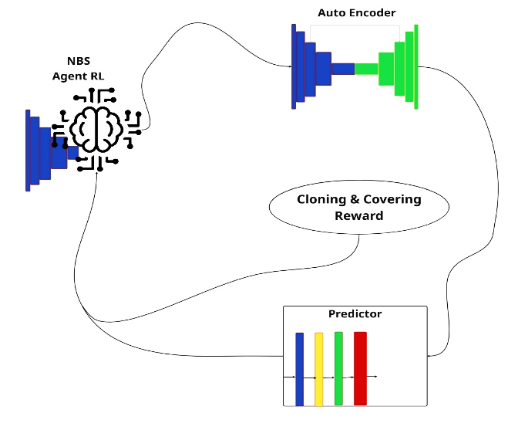
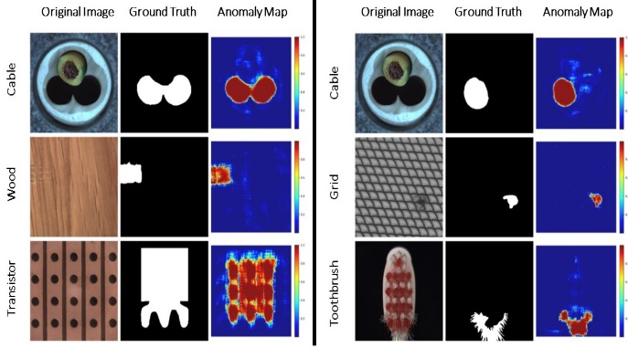

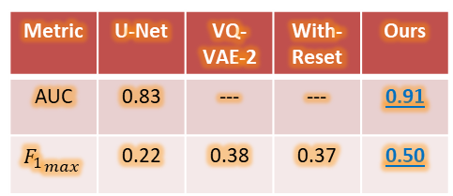
DRL-Guided Neural Batch Sampling for Semi-Supervised Pixel-Level Anomaly Detection
Amirhossein Khadivi Noghredeh, Abdollah Safari, Fatemeh Ziaeetabar*, Firoozeh Haghighi
* Corresponding author: Assistant Professor, Department of Computer Science, University of Tehran.
School of Mathematics, Statistics and Computer Science, College of Science, University of Tehran.
fziaeetabar@ut.ac.ir
Problem: Unsupervised methods overfit to normal data, miss subtle defects.
Proposal: Semi-supervised DRL framework (NBS + AE + Predictor).
Key idea: RL-based sampler adaptively selects informative patches via composite reward; AE generates loss profiles; Predictor segments anomalies.
Result: Avg. F1_max = 0.50 (+0.28 over U-Net), Avg. AUC = 0.91 (+0.08 over VQ-VAE-2).
Achievement: Better segmentation accuracy & robustness for subtle anomalies on MVTec AD.
Neural Batch Sampler: Focuses on informative regions → faster convergence.
Autoencoder: Produces stable loss profiles from reconstruction errors.
Predictor: Segments anomalies by mapping loss profiles to masks.
Limitations: High complexity, long training time, poor performance on very subtle defects.
Future work: Multi‑scale policies, transformers, diffusion‑based reconstruction.
Neural Batch Sampler (RL): Slides over & adaptively selects patches (9 discrete actions, REINFORCE).
Autoencoder (AE): Lightweight CNN, MSE loss, dropout before bottleneck → stable loss profiles.
Predictor: Loss-space FCN segmentation.
Goal: Improve pixel‑level anomaly detection for subtle industrial defects using only limited labeled anomaly samples.
Main innovations:
Adaptive sampling for balanced patch selection.
Removed reset mechanism + added dropout → stable reconstruction.
Simplified predictor (no historical loss profiles).
Expected outcome: Higher accuracy and better localization than other methods.
Metric | U-Net | VQ-VAE-2 | With-Reset | Ours
AUC | 0.83 | --- | --- | 0.91
$${F_{1}}_{max}$$ | 0.22 | 0.38 | 0.37 | 0.50
W.-H. Chu and K. M. Kitani, “Neural batch sampling with reinforcement learning for semi-supervised anomaly detection,” Proc. ECCV, 2020.
P. Bergmann, K. Batzner, M. Fauser, D. Sattlegger, and C. Steger, "The MVTec Anomaly Detection Dataset: A Comprehensive Real-World Dataset for Unsupervised Anomaly Detection," International Journal of Computer Vision, vol. 129, 2021.
E. K. Y. Yapp and N. C. N. Doan, “Anomaly detection on MVTec AD using VQ- VAE-2,” Procedia CIRP, vol. 130, 2024.
O. Ronneberger, P. Fischer, and T. Brox, “U-Net: Convolutional networks for biomedical image segmentation,” MICCAI, LNCS vol. 9351, 2015.
A. Khadivi Noghredeh, F. Haghighi, A. Safari, and F. Ziaeetabar, "DRL-Guided Neural Batch Sampling for Semi-Supervised Pixel-Level Anomaly Detection," IICAI 2026 (accepted).
Best results: Pill($F_{1}=0.68$), Hazelnut($0.67$), Cable($F_{1}=0.56$).

