Slide 1
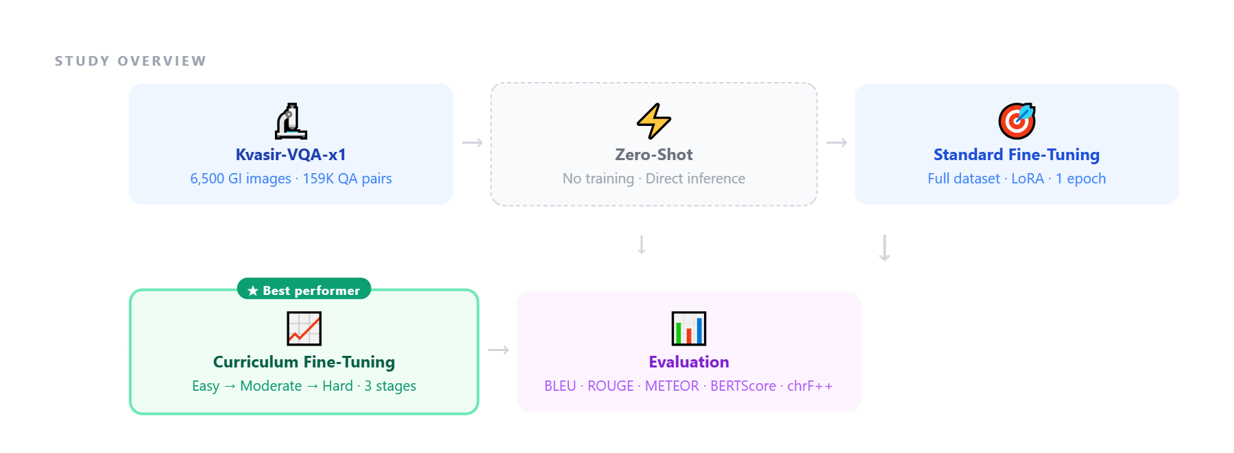
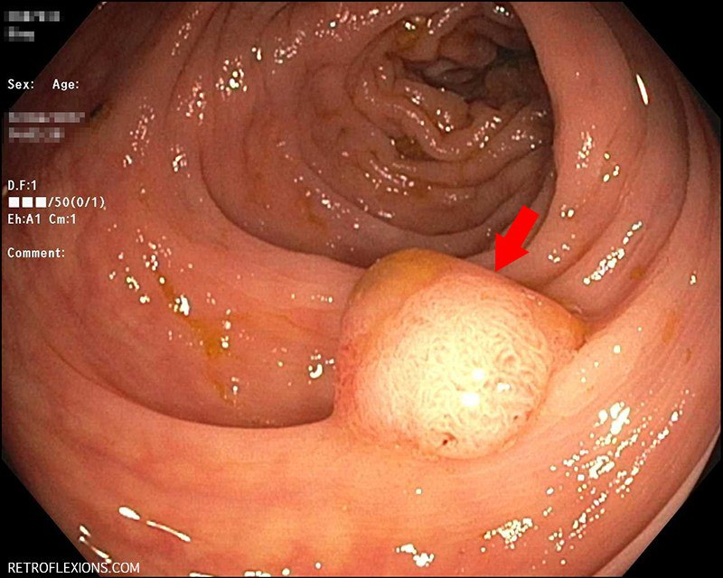
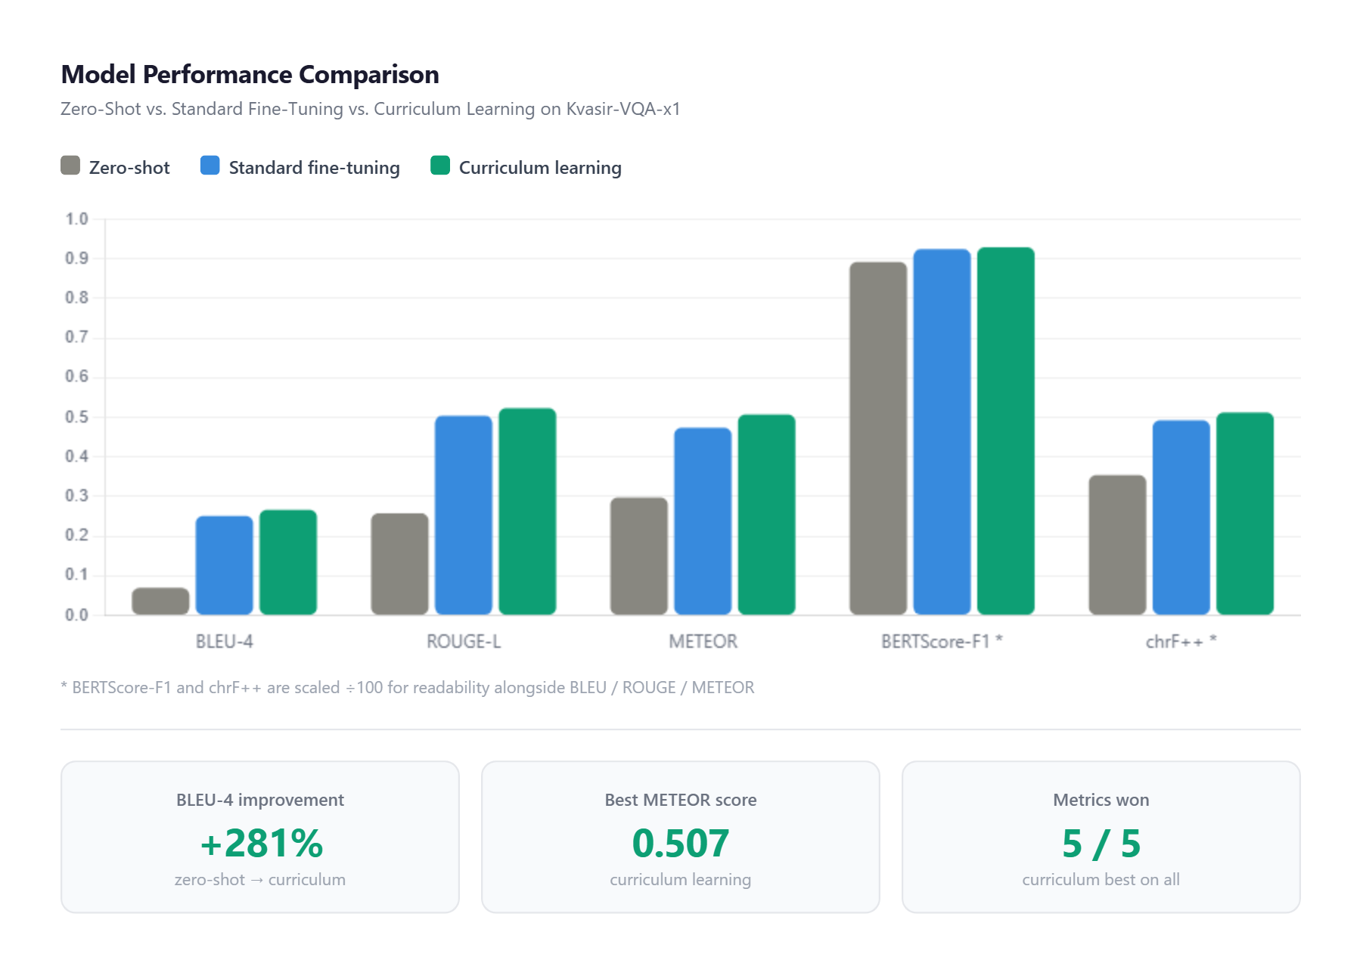
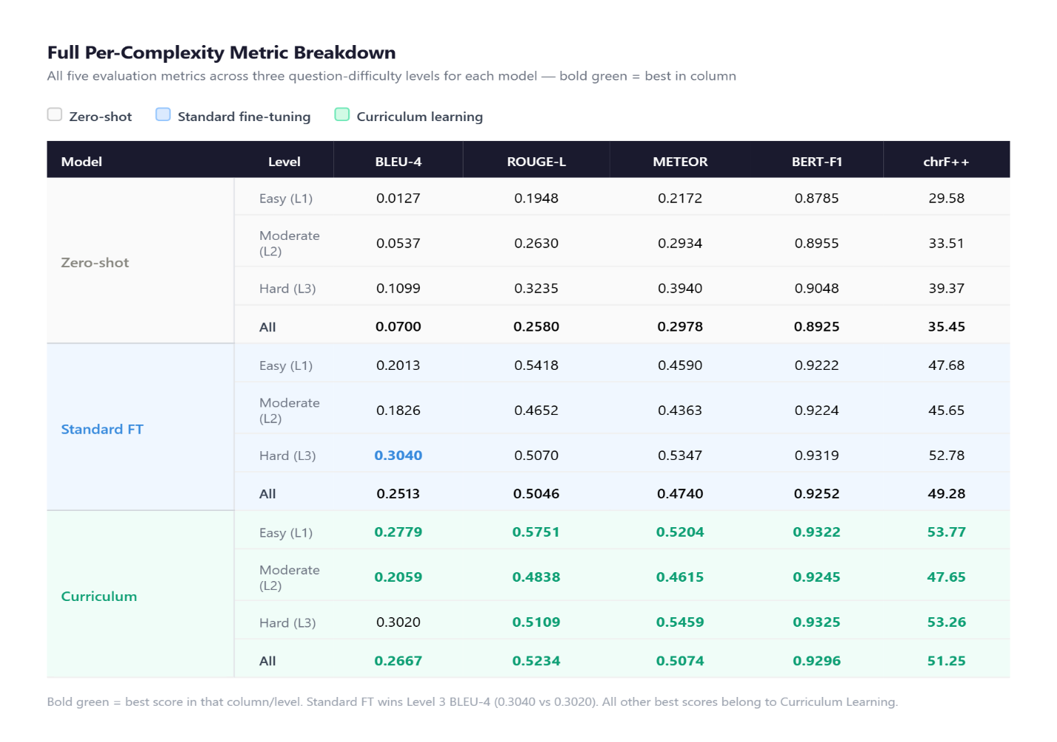
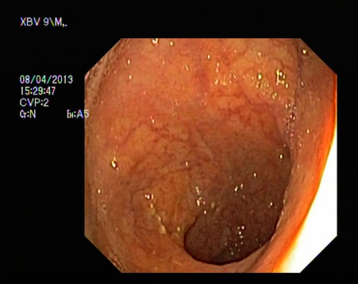
Zero-Shot, Standard Fine-Tuning, and Curriculum Learning Approaches for VQA in GI Endoscopy
Mahdi Azmoodeh-Kalati, Mohammad Sadegh Maghareh, Reza Lashgari*
1- M.Sc. in Biomedical Engineering ,Shahid Beheshti University, Tehran, Iran
2- M.Sc. in Computer Science , Amir Kabir University of Technology, Tehran, Iran
3- * Corresponding author: Ph.D. in Neuroscience, Shahid Beheshti University, Tehran, Iran
r_lashgari@sbu.ac.ir
Visual Question Answering (VQA) on gastrointestinal endoscopy images is a challenging multimodal task due to complex visual patterns and specialized clinical terminology. This study compares three inference strategies using a 2-billion-parameter vision–language model on the Kvasir-VQA-x1 dataset: (1) zero-shot inference, (2) standard fine-tuning, and (3) curriculum-guided fine-tuning. Using LoRA adaptation, domain-specific training significantly improves performance over zero-shot (BLEU 0.0700 → 0.2513). Curriculum learning further enhances accuracy (BLEU 0.2667), showing better generalization across varying question difficulties. Our three-stage curriculum repeats easy questions three times and moderate ones twice, reinforcing core knowledge. Overall, curriculum-guided fine-tuning provides more balanced and robust VQA performance compared to zero-shot and conventional fine-tuning.
Methodology:
Dataset: Kvasir-VQA-x1 — 6,500 GI endoscopy images, 159,000 QA pairs at 3 complexity levels (143,594 train / 15,955 test)
BaseModel:Qwen2-VL-2B-Instruct (4-bit quantized, single A100 40GB GPU)
Adaptation method: LoRA (Low-Rank Adaptation): rank r=16, α=16, ~14M trainable parameters (<1% of model). Enables efficient fine-tuning without updating all weights.
This project compared zero-shot inference, standard fine-tuning, and curriculum-guided fine-tuning for visual question answering in gastrointestinal (GI) endoscopy using a 2B vision–language model adapted to the Kvasir-VQA-x1 dataset via LoRA. Results show that domain-specific fine-tuning is crucial for bridging general pretrained capabilities and clinical needs, with zero-shot performance being limited. Standard fine-tuning improves results, while curriculum-guided training further enhances performance and yields more balanced outcomes across question difficulties, also reducing catastrophic forgetting. Overall, curriculum learning emerges as an efficient and practical approach for medical VQA in resource-constrained settings. This work highlights the importance of training strategies in improving robustness and generalization for clinical AI systems, with future work pointing toward adaptive and multimodal extensions.
strategy | description
Zero-shot | No training; direct inference with a clinical prompt
Standard Fine-Tuning | Full dataset, 1 epoch, LR = 5×10⁻⁵
Curriculum Learning | 3 stages: Easy → Easy+Moderate → All, with decreasing LR
Curriculum schedule:
Annotated endoscopic image showing a polyp, with model inference Q&A
Image was randomly downloaded from internet and does not belong to Kvasir_vqa_x1 dataset and asked from our curriculum learning trained model.
Q: Do we have polyp in the image?
A: Yes, polyp identified.
Q: Where is polyp located?
A: In central and lower regions.
Q: How many polyps are there in the image?
A: One polyp identified.
Complexity 3 question:
Q: Is there a polyp in the image, where is it located, and how many polyps are present?
A: There is a polyp located in the central and lower regions, with one identified.
stage | data | LR | Easy seen
Stage 1 | Level 1 only (49K pairs) | 5×10⁻⁵ | 1×
Stage 2 | Level 1+2 (96K pairs) | 3×10⁻⁵ | 2×
Stage 3 | All levels (143K pairs) | 2×10⁻⁵ | 3×
Evaluation metrics: BLEU-4, ROUGE-1/2/L, METEOR, BERTScore-F1, chrF++
Early AI-assisted endoscopy has focused on detection and classification. This work addresses the harder challenge of open-ended clinical reasoning via Medical VQA — answering diverse natural-language questions about endoscopy images.
Pretrained vision–language models struggle with specialized clinical queries out-of-the-box
Standard fine-tuning improves performance but can cause "catastrophic forgetting" of simple concepts
No prior work systematically compared zero-shot, standard, and curriculum fine-tuning specifically for GI endoscopy VQA
Goal: To evaluate whether a curriculum-guided training schedule — progressing from easy to complex questions — produces better and more balanced VQA performance than standard fine-tuning.
Experimental Results:
[1] C. Zhang and L. Wu, “The application of artificial intelligence in gastrointestinal endoscopy: a state-of-the-art review,” Journal of Digital Health, pp. 3–18, 2022.
[2] S. Gautam et al., “Kvasir-vqa: A text-image pair GI tract dataset,” in Proc. 1st Intl. Workshop on Vision-Language Models for Biomedical Applications, 2024, pp. 3–12.
[3] S. Gautam, M. Riegler, and P. Halvorsen, “Kvasir-vqa-x1: A multimodal dataset for medical reasoning and robust medvqa in gastrointestinal endoscopy,” in MICCAI Workshop on Data Engineering in Medical Imaging, Springer, 2025, pp. 53–63.
[4] Y. Bazi et al., “Vision–language model for visual question answering in medical imagery,” Bioengineering, vol. 10, no. 3, p. 380, 2023.
[5] M. Azmoodeh-Kalati et al., “Curriculum-guided fine-tuning for multimodal VQA in GI endoscopy (team lama4vision),” in MediaEval 2025 Workshop, Dublin, Ireland, 2025.
[6] A. Radford et al., “Learning transferable visual models from natural language supervision,” in ICML, PMLR, 2021, pp. 8748–8763.
[7] J.-B. Alayrac et al., “Flamingo: a visual language model for few-shot learning,” NeurIPS, vol. 35, pp. 23716–23736, 2022.
[8] E. J. Hu et al., “LoRA: Low-rank adaptation of large language models,” ICLR, 2022.
[9] T. Dettmers et al., “QLoRA: Efficient finetuning of quantized LLMs,” NeurIPS, vol. 36, pp. 10088–10115, 2023.
[10] Y. Bengio et al., “Curriculum learning,” in Proc. 26th ICML, 2009, pp. 41–48.
[11] G. Hacohen and D. Weinshall, “On the power of curriculum learning in training deep networks,” in ICML, PMLR, 2019, pp. 2535–2544.
[12] P. Wang et al., “Qwen2-VL: Enhancing vision-language model’s perception of the world at any resolution,” arXiv:2409.12191, 2024.
[13] K. Singhapoo, A. Inthanil, and A. Pillai, “Fine-tuning AI models with limited resources,” in ICEAST 2025, IEEE, 2025, pp. 148–151.
Example endoscopy image from the Kvasir-VQA-x1 dataset illustrating the type of visual input used for open-ended Medical VQA, where models must answer diverse clinical questions beyond simple detection or classification tasks.

