Slide 1
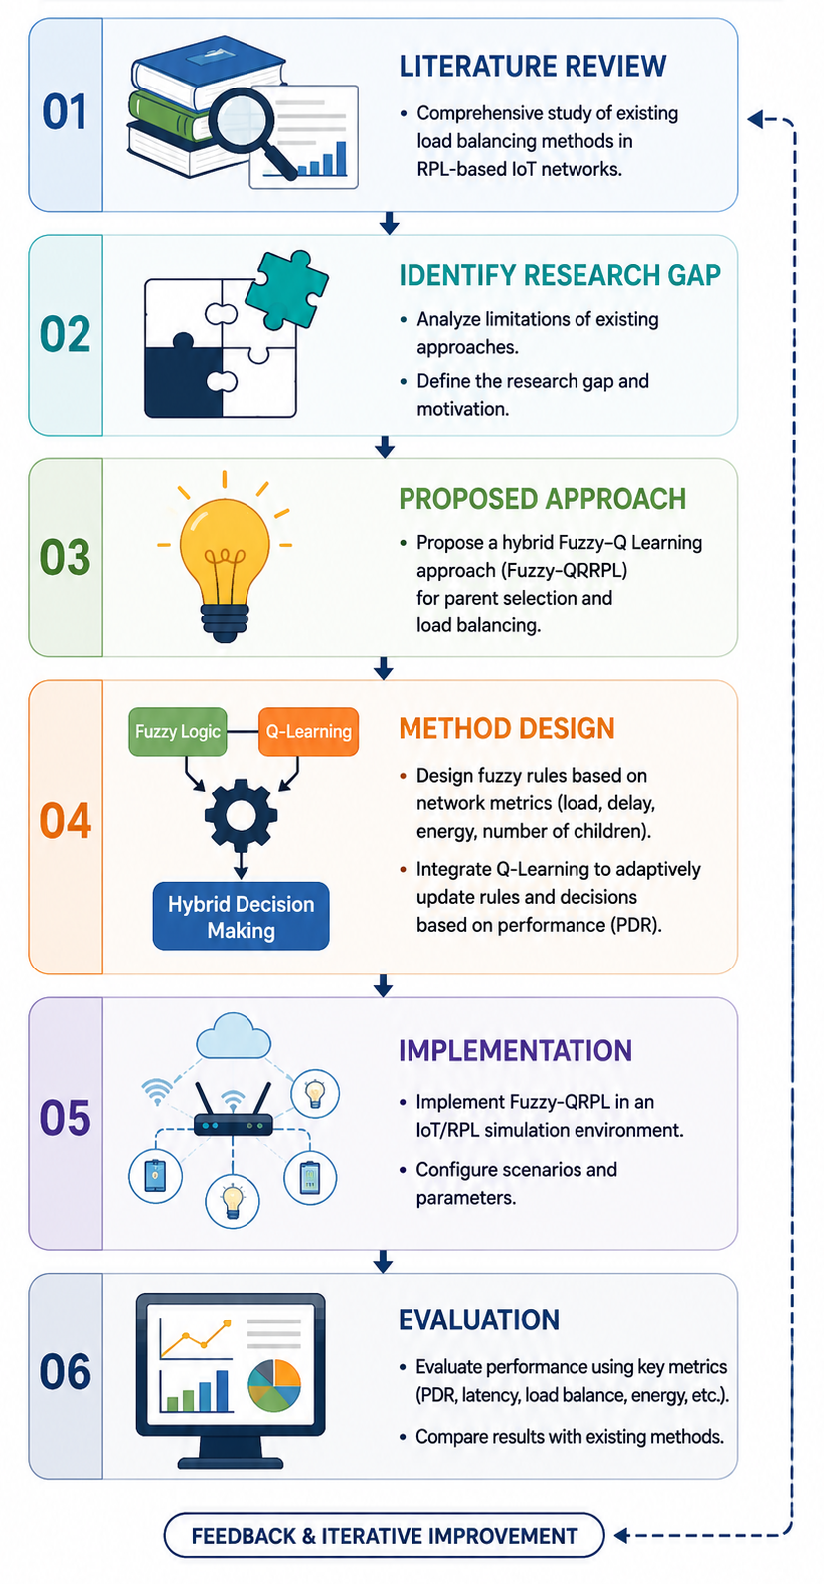
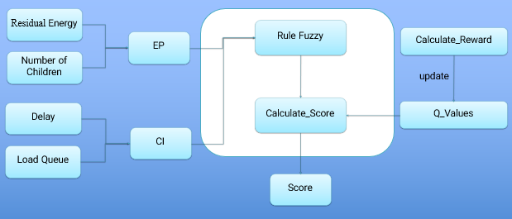
Hybrid Fuzzy‑Q Learning Approach for Load Balancing in IoT Networks
Fereshteh Taghizadeh*, Mohsen Raji, Morteza Keshtkaran
School of Electrical and Computer Engineering, Shiraz University
ftaghizadeh@shirazu.ac.ir
Artificial Intelligence is redefining the optimization of complex IoT routing systems, enabling adaptive, data‑driven decision‑making in scenarios where traditional methods fall short. In traditional IoT networks, maintaining reliable and energy‑efficient routing under dynamic traffic patterns and topology changes remains a critical challenge. To address this, we propose Fuzzy‑QRPL, a hybrid load‑balancing framework that integrates fuzzy logic with Q‑learning to enhance routing efficiency in RPL-based IoT networks. Two key metrics—Residual Energy Potential (EP) and Congestion Index (CI)—are computed from queue occupancy, end‑to‑end delay, number of child nodes, and residual energy. Nine fuzzy rules are defined, each initialized with a Q‑value and updated according to a reward based on the packet delivery ratio (PDR). This AI‑enhanced mechanism enables dynamic and intelligent parent selection under varying network conditions. Cooja simulation results across diverse network sizes demonstrate that Fuzzy‑QRPL significantly improves PDR, reduces delay, and increases the number of successfully delivered packets compared to conventional RPL objective functions.
This research began with a comprehensive review of existing load balancing approaches in IoT and RPL-based networks. After identifying the limitations of current methods in handling dynamic network conditions, a research gap was defined.
To address this issue, a hybrid approach combining Fuzzy Logic and Q-Learning was proposed for intelligent parent selection and load balancing in IoT networks. The proposed method was then implemented and evaluated through simulation experiments. Finally, its performance was compared with existing approaches using key network performance metrics
This paper introduced Fuzzy-QRPL, a hybrid load-balancing mechanism for RPL that integrates fuzzy logic with Q-learning. Two primary metrics—Residual Energy Potential (EP) and Congestion Index (CI)—were constructed from four network indicators and incorporated into nine fuzzy rules whose weights are dynamically updated through Q-learning. This enables adaptive and context-aware parent selection beyond traditional static fuzzy approaches. Extensive simulations using Cooja simulator show that Fuzzy-QRPL consistently achieves higher PDR, lower delay, and more efficient packet transmission compared with MRHOF and FL-HELR-OF, especially in larger network deployments. These results demonstrate that combining fuzzy inference with reinforcement learning offers an effective and scalable solution to RPL’s load-balancing limitations in IoT environments.
This research proposes Fuzzy-QRPL, a hybrid load-balancing method for RPL-based IoT networks. The approach combines Fuzzy Logic and Q-Learning to improve parent selection and reduce network congestion.
The method evaluates nodes using metrics such as residual energy, queue load, delay, and number of children. These metrics are processed through fuzzy rules to calculate Energy Potential (EP) and Congestion Index (CI) for selecting the best parent node.
Q-Learning continuously updates decision rules based on network performance, enabling adaptive and intelligent routing in dynamic IoT environments.
[1] Wireless Sensor Networks: A Big Data Source in IoT
[2] Routing Protocol for Low-Power and Lossy Wireless Sensor Networks
[3] Efficient Topology Construction for RPL
[4] RPL: IPv6 Routing Protocol for LLNs
[5] Simulation of the RPL Routing Protocol
[6] Optimization of Parent-Node Selection in RPL
[7] TFUZZY-OF for RPL Load Balancing
[8] Fuzzy Logic Based Objective Function for RPL
[9] FAHP-OF: Load Balancing in RPL-based IoT
[10] Fuzzy Logic Based Energy-Aware Routing
[11] OF-FZ: Optimized Objective Function for LLNs
[12] OF-EC: Energy Consumption Aware Objective Function
[13] Innovative RPL Objective Function Using Fuzzy Logic

