Slide 1
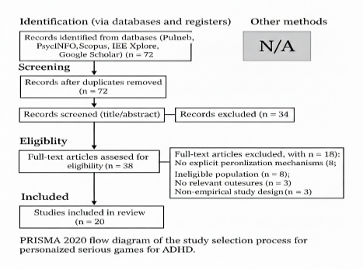
Personalized Serious Games for ADHD: A Systematic Review and Evidence Synthesis
1st Mohammad Cheraghi, 2nd Milad Hassani, *3rd Niloofar Mirzaei Chahardeh
1st Dept. of Computer Engineering CT.B., Islamic Azad University, Tehran, Iran, Email: Mohammad.Cheraghi@iau.ir
2nd Dept. of Information and Technology Management, College of Farabi, University of Tehran, Qom, Iran, Email: Miladhassani@ut.ac.ir
*3rd Dept. of Computer Engineering SR.C., Islamic Azad University Tehran, Iran, Email: Niloofar.Mirzaeichahardeh@iau.ir (Corresponding author)
Adaptive serious games offer engaging therapeutic tools for pediatric ADHD by tailoring tasks to individual cognitive profiles. This systematic review synthesizes 20 studies (2011–2024) evaluating these interventions. Core personalization mechanisms encompassed dynamic difficulty adjustment, individualized feedback, and customized rewards. Compared to fixed-difficulty controls, adaptive interventions yielded modest-to-moderate improvements in working memory and attentional capacity, maintaining high user engagement with minimal adverse effects. However, evidence certainty is constrained by methodological limitations, including small sample sizes and moderate-to-high risk of bias. Consequently, while personalized games constitute a promising supplementary treatment for ADHD, future research must prioritize algorithmic transparency, standardized outcome measures, and rigorous designs with extended follow-ups to establish definitive clinical efficacy
Reporting Standards: Adhered to PRISMA 2020 guidelines to ensure systematic transparency [3].
Eligibility Criteria: Included pediatric ADHD populations (≤18 years) using adaptive digital interventions [7].
Search Strategy: Executed a multi-database search (PubMed, Scopus, IEEE) through August 2024.
Study Selection: Filtered 72 initial records to 20 high-quality empirical investigations for final synthesis.
Quality Assessment: Evaluated bias risks using Cochrane RoB 2 and ROBINS-I frameworks to ensure validity.
The following PRISMA flow diagram illustrates the step-by-step process of our literature search, screening, and the final selection of the 20 included studies.
Promising Adjunct
Personalized games are effective supplements to ADHD multimodal care [1], [6].
Key Drivers
Adaptive difficulty and individualized feedback are the primary therapeutic levers [4].
Current Gaps
Methodological bias and lack of long-term tracking (>12 weeks) remain challenges.
Research Need
Future trials must prioritize algorithmic transparency and standardized outcomes [3].
Fig. 1. PRISMA 2020 flow diagram of the study selection process.
Overcoming Treatment Barriers
Addressing side effects and accessibility issues of conventional therapy [2].
Addressing Static Limits
Replacing fixed-difficulty games that fail moment-to-moment ADHD variability [4].
Flow State Maintenance
Utilizing real-time adjustments to keep users in the optimal "Flow Zone" [5].
Evidence Synthesis
Consolidating fragmented data on algorithmic personalization and clinical outcomes [7].
Cross-Disciplinary Trends
Applying personalization principles seen in broader chronic disease management [8].
Scale
Synthesis of 20 clinical trials involving 843 total participants.
Efficacy
Over 50% of studies reported moderate-to-strong gains in sustained attention [6].
Mechanism Impact
Strongest gains occurred when difficulty adjusted to real-time performance [4], [5].
Safety
Zero serious adverse effects; high adherence across all digital platforms [7].
[1] G. Polanczyk et al., "ADHD prevalence estimates," Int. J. Epidemiol., 2014.
[2] S. Cortese et al., "Medications for ADHD: Systematic review," The Lancet Psychiatry, 2018.
[3] M. J. Page et al., "The PRISMA 2020 statement," BMJ, 2021.
[4] P. Prins et al., "Computerized working memory training," Cyberpsychology, 2011.
[5] S. Dovis et al., "Can motivation normalize working memory?" J. Abnorm. Child Psychol., 2012.
[6] S. Kollins et al., "Novel digital intervention (STARS ADHD)," The Lancet Digital Health, 2020.
[7] J. Lin et al., "Serious Games as Digital Therapeutics," JMIR Serious Games, 2025.
[8] H. Hermans et al., "Depression in coronary heart disease," J. Affect. Disord., 2024.

